Slide 1





Radar Constraints on the Thickness of Subsurface Ice Near Hellas Planitia, Mars
Claire Cook
A. M. Bramson, S. Byrne
Lunar and Planetary Laboratory, University of Arizona
Space Grant Symposium
April 13th, 2019
Notes:
Go straight into next slide don’t say anything here

Slide 2
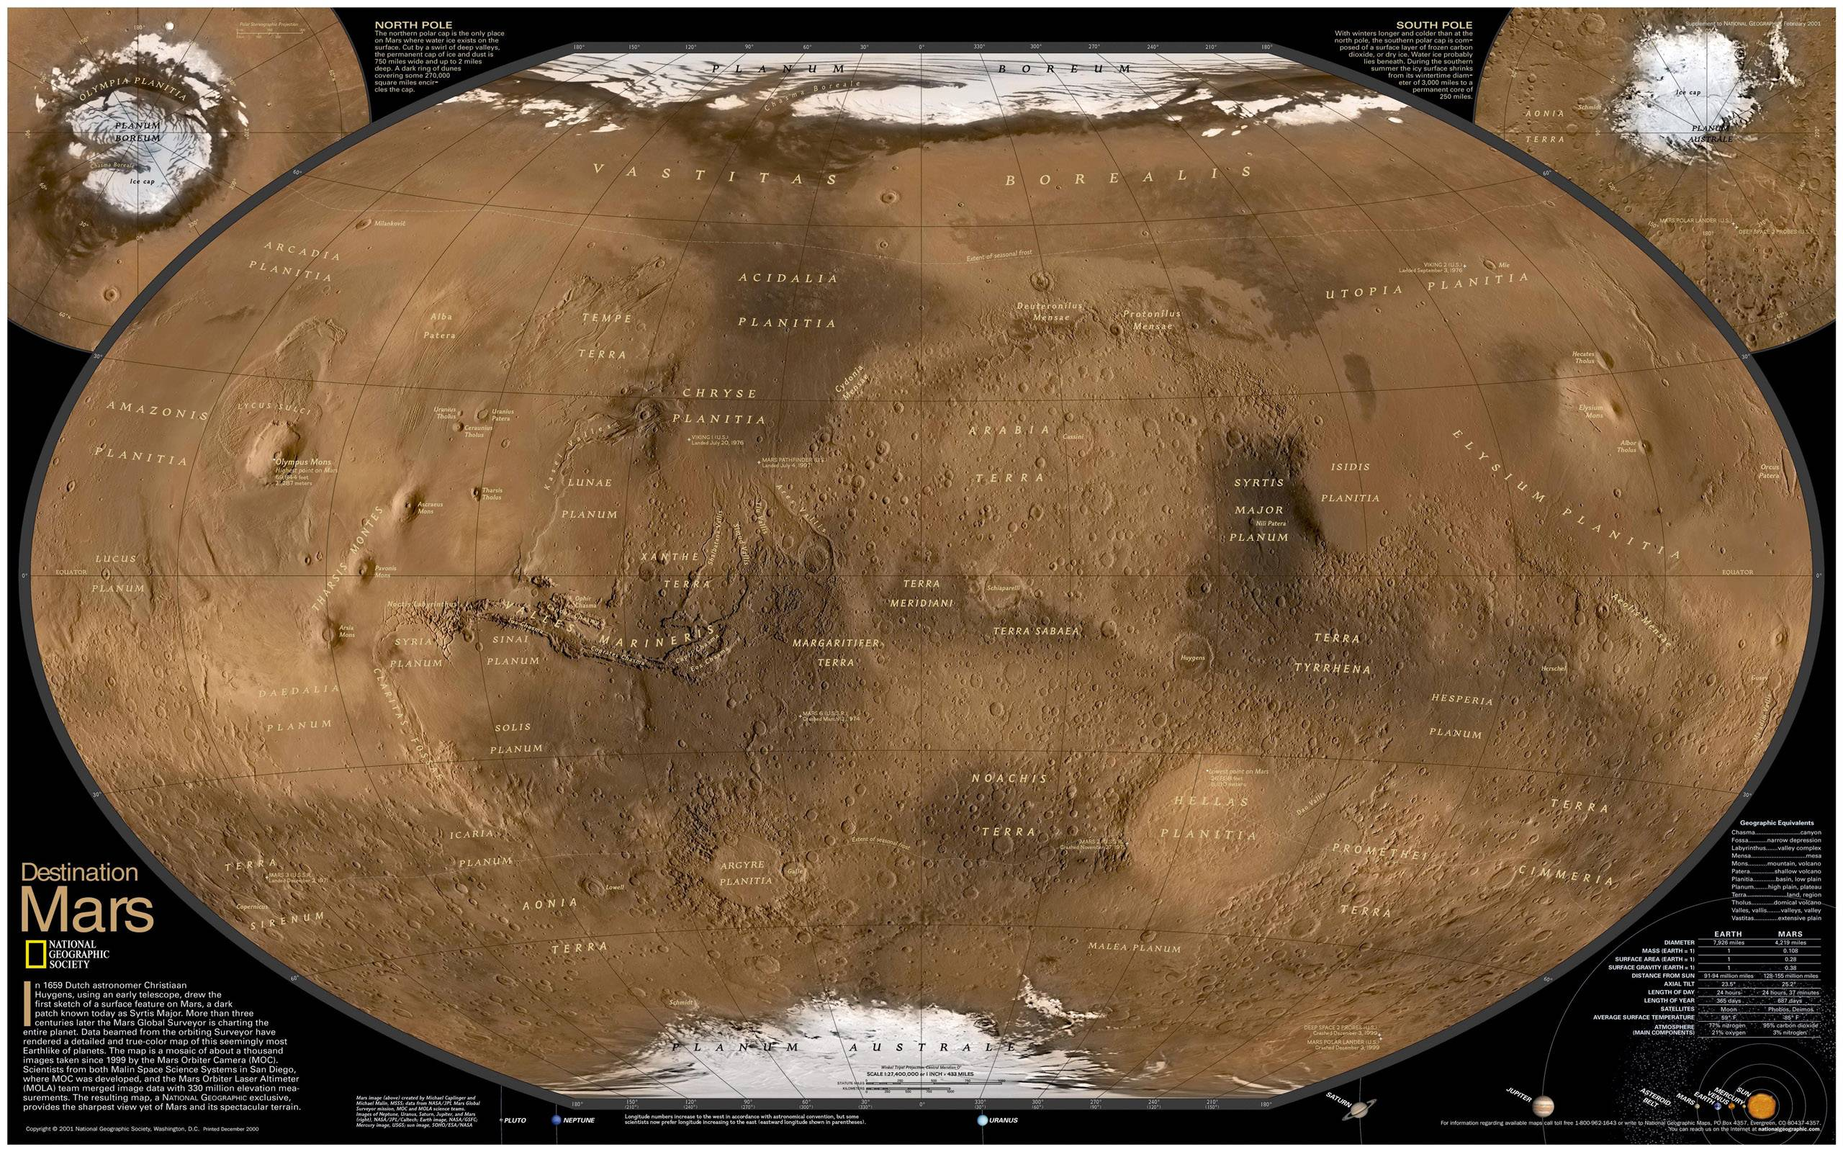
Notes:
At the poles: ice stable at the surface. In the equatorial regions: ice not stable at any depth. In the midlatitudes: ice stable in the near subsurface.

Slide 3
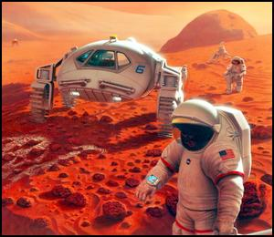
Motivation
Gives insight into Mars’ climate history and water budget
Could be a resource for future human exploration
Image credit: NASA/Pat Rawlings
Notes:
Mention constraining various factors like the quantity, distribution (where ice is located), and purity (whether deposits are pure ice or a mixture of ice and rock) and how those can tell us something about for example how the ice was emplaced.

Slide 4
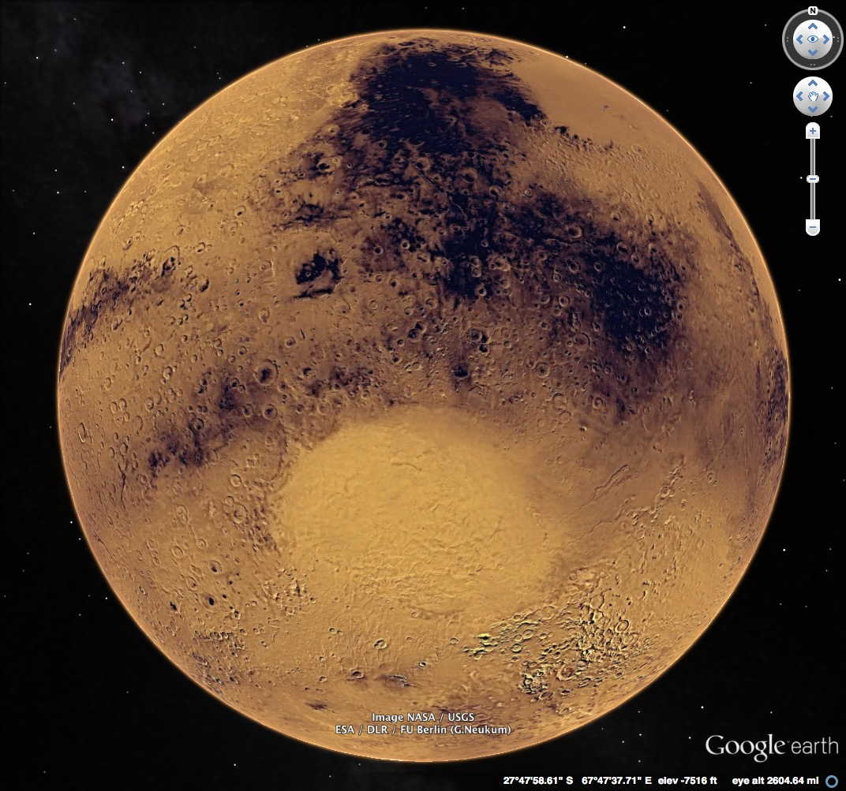
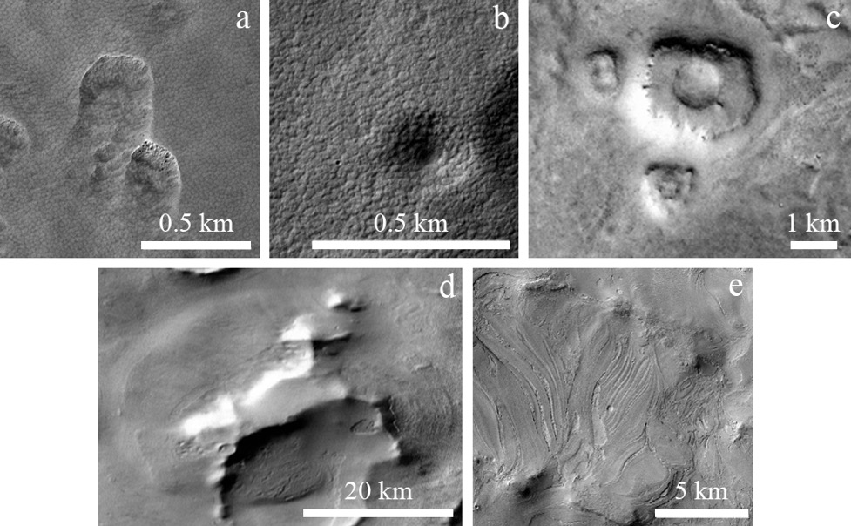
Study Area
Scalloped depressions
Expanded craters
Pedestal craters
Hellas Planitia
Lobate debris aprons
Banded terrain
Image credit: NASA/USGS
Features potentially associated with subsurface ice found in/around Hellas Planitia
Notes:
Hellas Planitia: big crater in the southern hemisphere

Slide 5
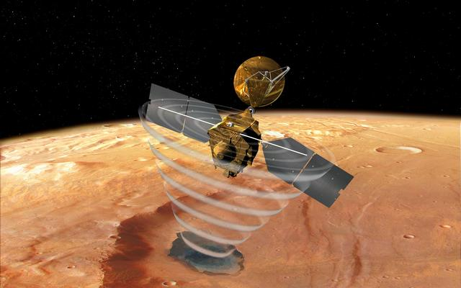
Methods: Radar
Allows us to probe the subsurface
  Radar reflects off the interface between materials with different dielectric constants
  Dielectric constant relates to the speed at which electromagnetic waves move through a material
SHAllow RADar (SHARAD) on the Mars Reconnaissance Orbiter
  Looked at radargrams for 368 tracks covering Hellas Planitia
Image credit: NASA/JPL
Notes:
Interfaces: Atmosphere-surface. Ice-rock. Dielectric constant: allows us to potentially characterize what the material is or how much of some material a radar wave has gone through. Maybe mention that sharad can detect 10-20 m thick layers and based on other estimates of ice thickness in the southern hemisphere then it might be able to resolve ice layer here.

Slide 6
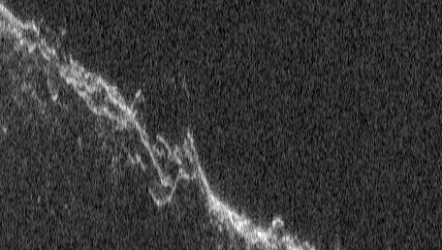
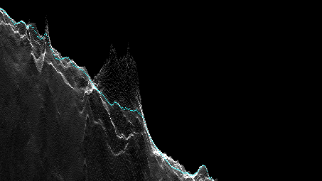
Methods: Clutter
Reflections from off-nadir surface topography
Can appear at delay times similar to subsurface reflectors
To avoid: compare to simulations of what the radar would see based solely on surface topography
Radargram
Clutter simulation

Slide 7
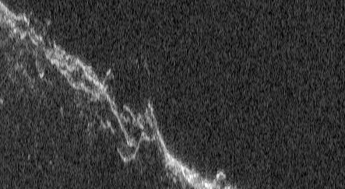
Radargram
Time delay
Distance along track
Notes:
Point out the reflector

Slide 8
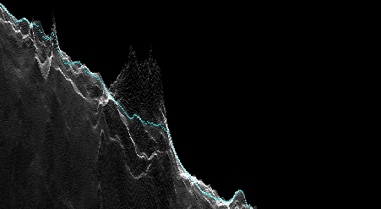
Clutter simulation
Time delay
Distance along track

Slide 9
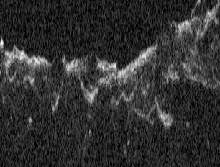
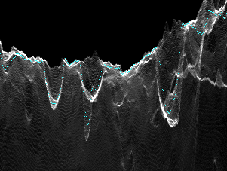
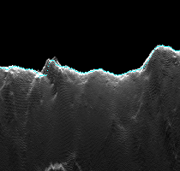
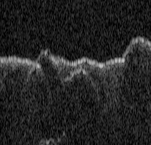
Methods: Confidence Rating
LC1: contiguous with clutter
LC2: curved
LC3: both of those
LC4: possible clutter, but difficult to tell because power not accurately modeled
LC5: similar in size/shape to nearby clutter
LC6: may correspond to clutter shifted from where it’s expected based on simulation
LC1
LC2

Slide 10
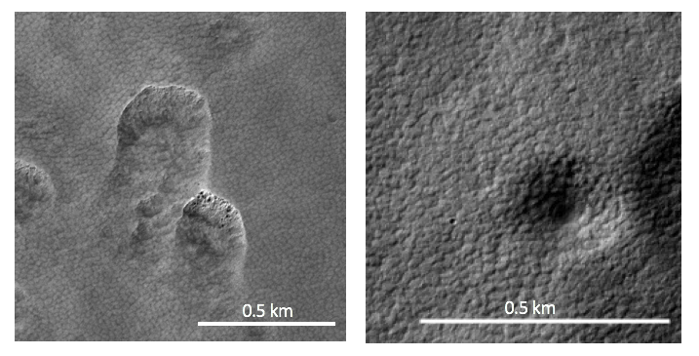
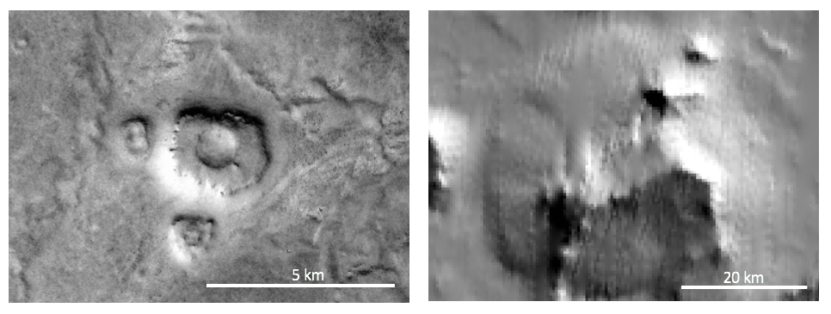
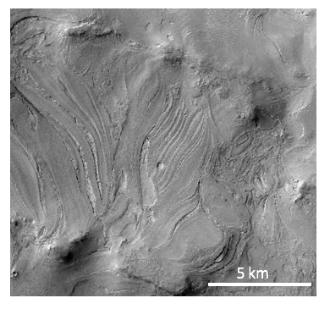
Methods: relationship to ice features
For reflectors we have higher confidence in, looked at Context Camera (CTX) images of the area to identify features potentially associated with ice
Scalloped depressions
Expanded craters
Pedestal craters
Lobate debris apron
Banded terrain
Notes:
looked for features ~20 km from reflector

Slide 11
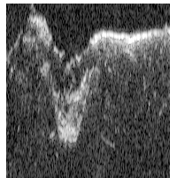
Higher Resolution Clutter Simulations
Checked 40 reflectors with High Resolution Stereo Camera (HRSC) digital terrain model (DTM) based clutter simulations
4 CTX DTM based clutter simulations, but only able to check 1 reflector
Notes:
Note that the reflectors checked were already in the higher confidence category

Slide 12
Checking higher resolution simulations

Slide 13
Checking higher resolution simulations

Slide 14
20°S
40°S
60°S
40°E
60°E
80°E
100°E
Notes:
Say overall numbers here: 593 candidate radar reflectors with higher confidence in 187

Slide 15
Most reflectors likely unresolved clutter
86% are <10 km long
27/40 higher confidence reflectors (67.5%) appeared to be clutter in HRSC simulations.
Notes:
Also add that one reflector appeared to be clutter in the one really useable ctx sim.

Slide 16
Depth constraints
Feature | Median one-way time delay (ns) | Median depth with ε_{r}=3.15 (m) | Median depth with ε_{r}=8 (m)
Scalloped depressions (18) | 600 | 101 | 64
Expanded craters (4) | 778 | 131 | 82
Near pedestal craters (12) | 628 | 106 | 67

Slide 17
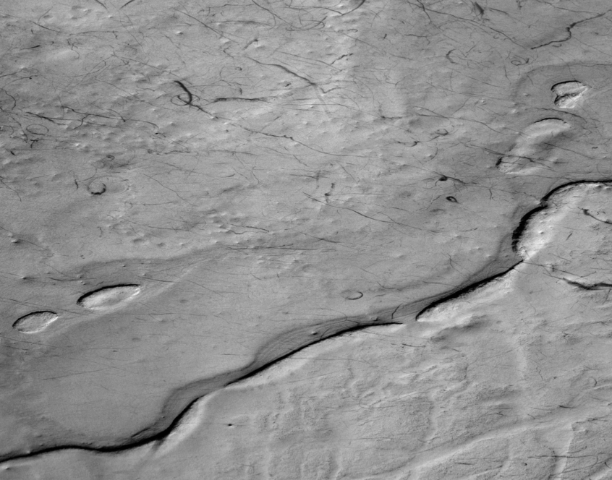
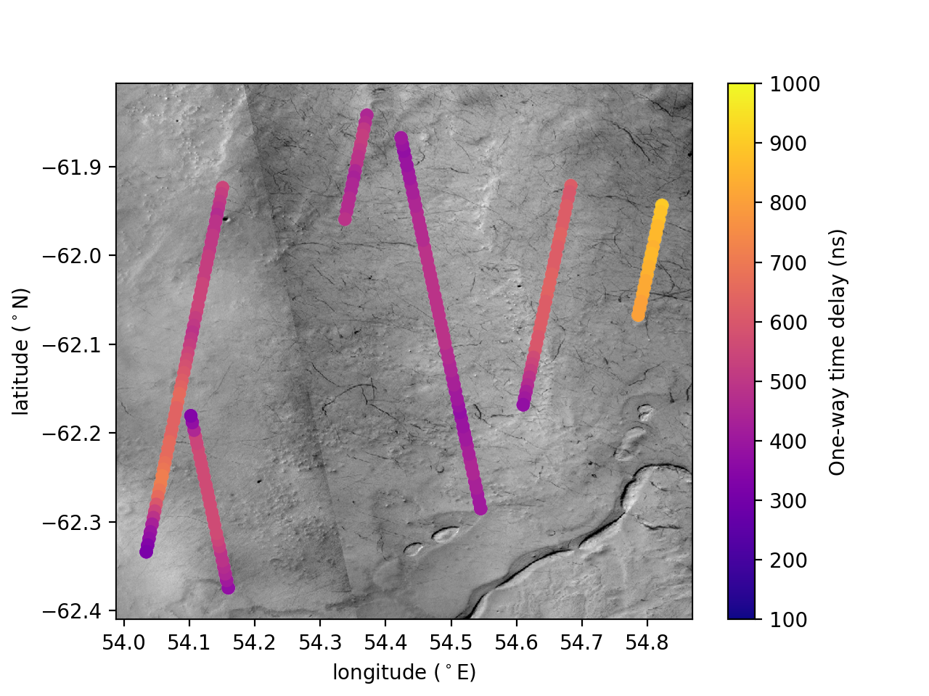
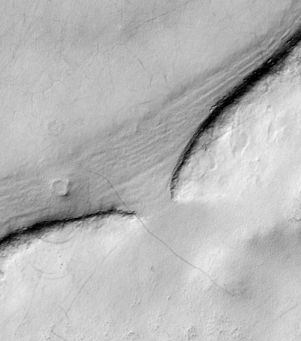
Reflectors in Malea Planum
Notes:
Hirise image ESP_014018_1175.

Slide 18
Reflectors in Malea Planum
6 adjacent reflectors
Median depth of 89 m assuming ε_{r}=3.15 and 56 m assuming ε_{r}=8
Associated with plateau ~ 36 𝗑 43 km and 200 m tall.
Some reflectors potentially draping underlying topography
23 km
20 km

Slide 19
Conclusions
Most candidate reflectors likely unresolved clutter
  Ice-rich layer may be present but difficult to detect with SHARAD
Constraints on ice thickness
  From high confidence group of reflectors in Malea Planum: ~ 90—60 m depending on ice/rock ratio
Notes:
elaborate that ice rich layer may be too thin for SHARAD to detect, have a gradual boundary with the underlying unit, be obscured by the high amount of clutter in the region. Note that thickness

Slide 20
Acknowledgements
J. W. Holt and M. S. Christoffersen: provided clutter simulations
T. A. Goudge: provided script to make CTX DTMs

Slide 21
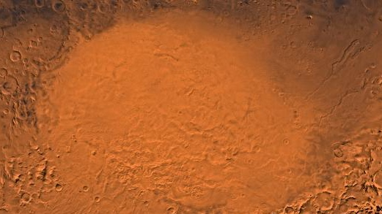
Thank You!
Notes:
8 min

